Slide 1
Discrete Mathematics (CSC 1204)
Conditional Statements (section 1.1)
(Supplementary Materials)

Slide 2
Conditional Statements
Let p and q be propositions.
The conditional statement p → q is the proposition “if p, then q.”
The conditional statement p → q is false when p is true and q is false, and true otherwise.
In the conditional statement p → q,
p is called hypothesis (or antecedent or premise) and
q is called conclusion (or consequence)
This one is the English usage of “if, then” or “implies”.
The connective → is called the ‘conditional connective’.
A conditional statement is also called an implication.

Slide 3
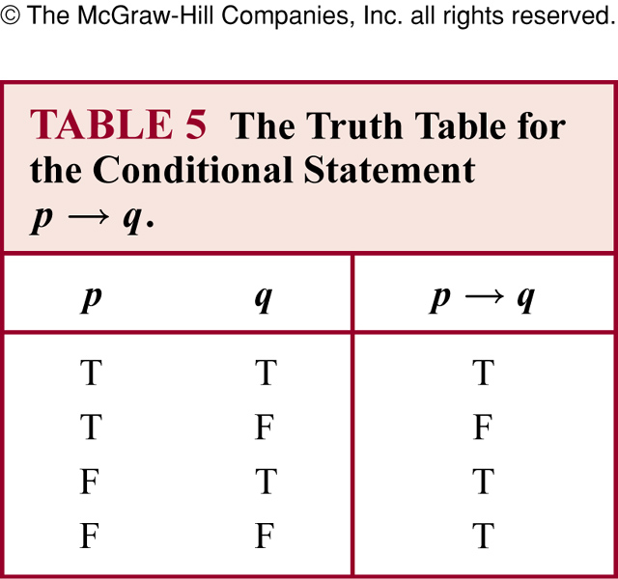
Truth Table for Conditional Statement

Slide 4
Equivalent Expression of p → q
In terms of words, the proposition p → q also reads:
(a) if p, then q, or
if p, q
(The word “then” is sometimes omitted in English sentences)
(b) p implies q
(c) p is a sufficient condition for q , or
a sufficient condition for q is p
(d) q is a necessary condition for p, or
a necessary condition for p is q

Slide 5
Equivalent Expression of p → q
(e) p only if q
(f) q if p , or
q, if p
(g) q whenever p
(h) q when p
(i) q unless ¬p

Slide 6
Remember!
The hypothesis expresses a sufficient condition
The conclusion expresses a necessary condition
“but” is a logical synonym for “and”
“when” / “whenever” means the same as “if”
The hypothesis is the clause following “if”
The conclusion is the clause following “then”
“only if” clause is the conclusion

Slide 7
Question pattern in the midterm exam?
Question may be in one of the following forms:
Write each of these statements in the form “if p, then q” in English
Write each of these statements in the form “if p, then q”
Write each of these statements in the form “if … , then ...”
Restate each of these proposition in the form “if p, then q”
EXAMPLES next slides ➔

Slide 8
Exercise 19
Write each of these statements in the form “if p, then q” in English.
It snows whenever the wind blows from the northeast
A: If the wind blows from the northeast, then it snows
b) The apple trees will bloom if it stays warm for a week
A: If it stays warm for a week, then the apple trees will bloom

Slide 9
Exercise 19
c) That the Pistons win the championship implies that they beat the Lakers
A: If the Pistons win the championship, then they beat the Lakers
d) It is necessary to walk 8 miles to get to the top of Long’s Peak
A: If you get to the top of Long’s Peak, then you must have walked eight miles

Slide 10
Exercise 19
e) To get tenure as a professor, it is sufficient to be world-famous
A: If you are world-famous, then you will get tenure as a professor
f) If you drive more than 400 miles, you will need to buy gasoline
A: If you drive more than 400 miles, then you will need to buy gasoline

Slide 11
Exercise 19
g) Your guarantee is good only if you bought your CD player less than 90 days ago
A: If your guarantee is good, then you must have bought your CD player less than 90 days ago
h) Jan will go swimming unless the water is too cold
A: If the water is not too cold, then Jan will go swimming

Slide 12
Practice @ Home
Relevant odd-numbered exercises

